Slide 1
Shared Folder
By Navjot Singh

Slide 2
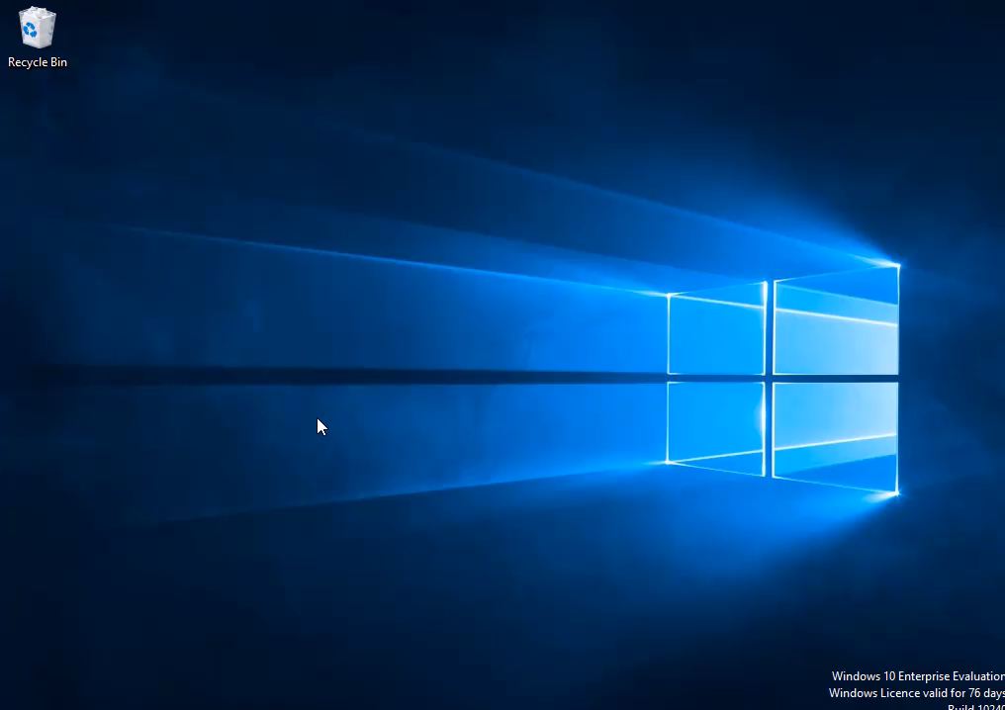
Setting Up Users

Slide 3
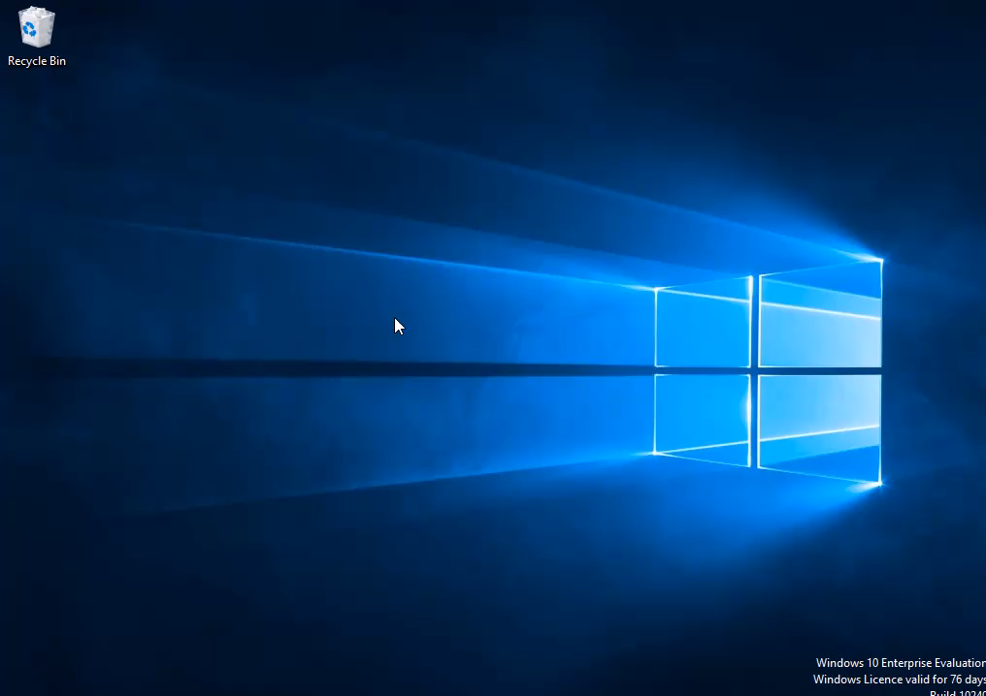
Setting up group

Slide 4
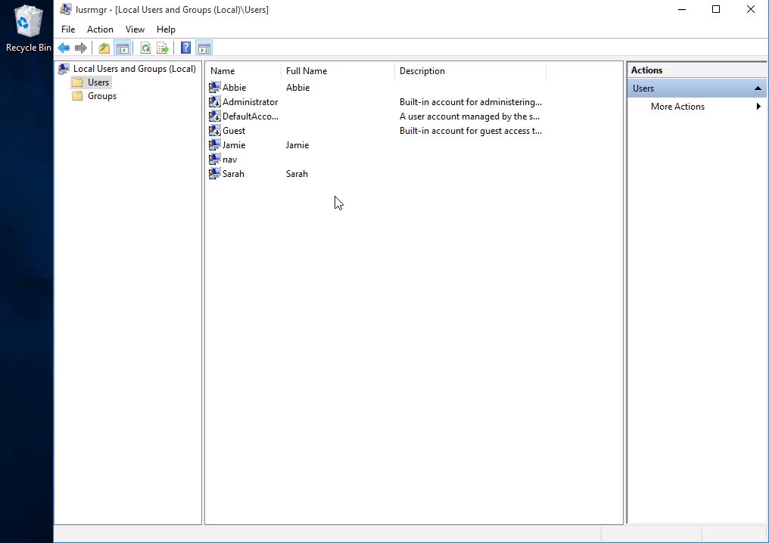
Setting users into groups

Slide 5

Setting up shared folder and restrictions

Slide 6
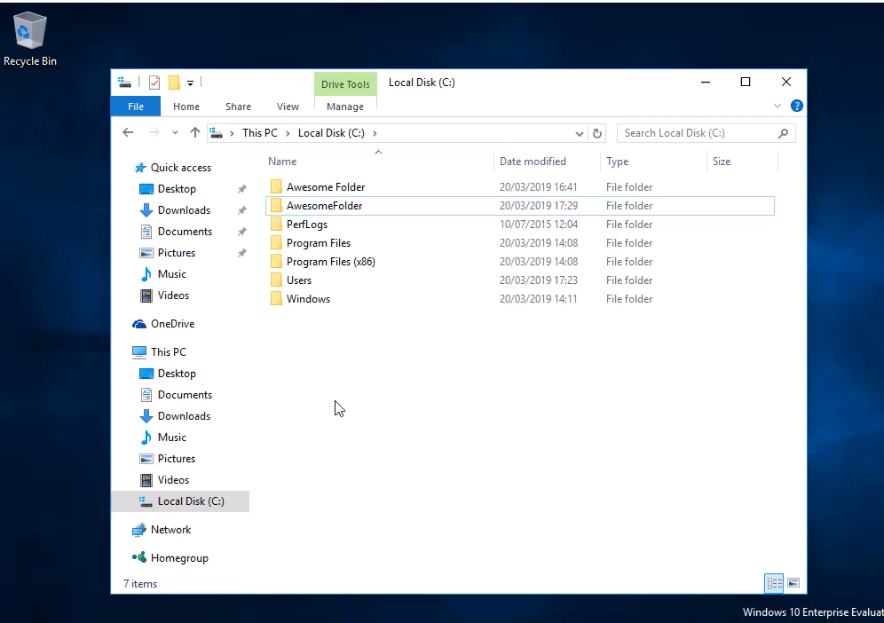
Test 1
Abbie cannot access the group because she is not in the group

Slide 7
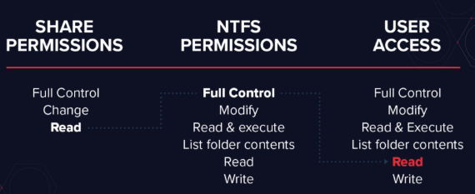
Justify
Here we can see the different restrictions there are.
Share permissions are a great way to restrict access to different users with in your network.

Slide 8
Justify
All though permissions are genuinely secure, it does have its downfalls. Lets say you have multiple shared files on a server which are nested within one another, setting permissions to the files can get messy real quick depending on how many files there are.
For example, lets say that you set a subfolder to read only, but then you proceed to set the folder above to allow “modify” permissions at a higher root, you will risk people getting more higher level access then what you intended.
There is a way around this, the solution is to utilise the power of both share permissions and NTFS permissions. For example if the share permission is “modify” and the NTFS permission is “read” then they will be given a read permission.

